Slide 1
Fostering a Growth Mindset
Increasing achievement for students living in poverty.

Slide 2
What is a Growth Mindset?

Slide 3
Create a definition of a growth mindset
Write three things you know about growth mindsets.
Share your insights with a partner.
In teams of 3-5 write a definition of a growth mindset.

Slide 4
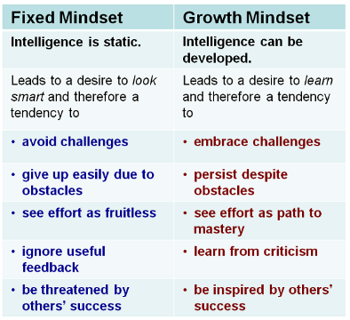

Slide 5
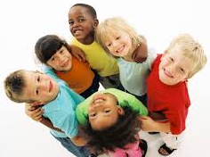
Why mindsets matter
Students come to school in kindergarten believing that they can learn.

Slide 6
Grade | Fixed Mindset | Growth Mindset
K | n/a | 100%
1 | 10% | 90%
2 | 18% | 82%
3 | 42% | 58%
Mindsets in the Classroom, Mary Cay Ricci 2013 p. 11

Slide 7
The classroom teacher is still the single most significant contributor to student achievement; the effect is greater than that of parents, peers, entire schools, or poverty (Hanushek, 2005; Haycock, 1998; Rivkin, Hanushek, & Kain, 2005; Rockoff, 2004).

Slide 8
How can we encourage growth mindsets in our classrooms?

Slide 9
Build relationships
Believe students can learn
YET

Slide 10
Build relationships

Slide 11
Relationships mean more to students who have instability at home.
When teachers offer strong instructional and emotional support, students from low income families perform equal to their higher-income peers (Hamre & Pianta, 2005)
Students who like their teacher perform better.

Slide 12
Turn and Talk
How can you work to build relationships with your students?

Slide 13
Fifty-Fifty Rule

Slide 14
16 of 18 high-achieving students told researchers they had strong peer support networks, compared with just 1 of 17 underachievers.
To effectively impact academic achievement, teachers should split class time equally between social time and individual time --- Fifty-Fifty rule.

Slide 15
Social Time | Individual Time
Cooperative groups and teams | Solo time for journaling and mind mapping
Study buddies or partners to quiz each other | Students practice self-testing
Temporary partners for summarizing time | Goal setting and self-assessment
Learning stations for social data gathering | Reading, reflection, and writing
Group projects for brainstorming | Seatwork for problem solving

Slide 16
Believe students can learn

Slide 18
A teacher’s mindset predicts student success even more than IQ, socioeconomic status or reading level (Tough, 2012).

Slide 19
Model High Achievement Thinking
Start with a smile and positive greeting.
Show you are happy with student progress
Smile more than you think you need to.

Slide 20
Students won’t do what you don’t expect or ask them to do (Jensen, 2016).

Slide 21
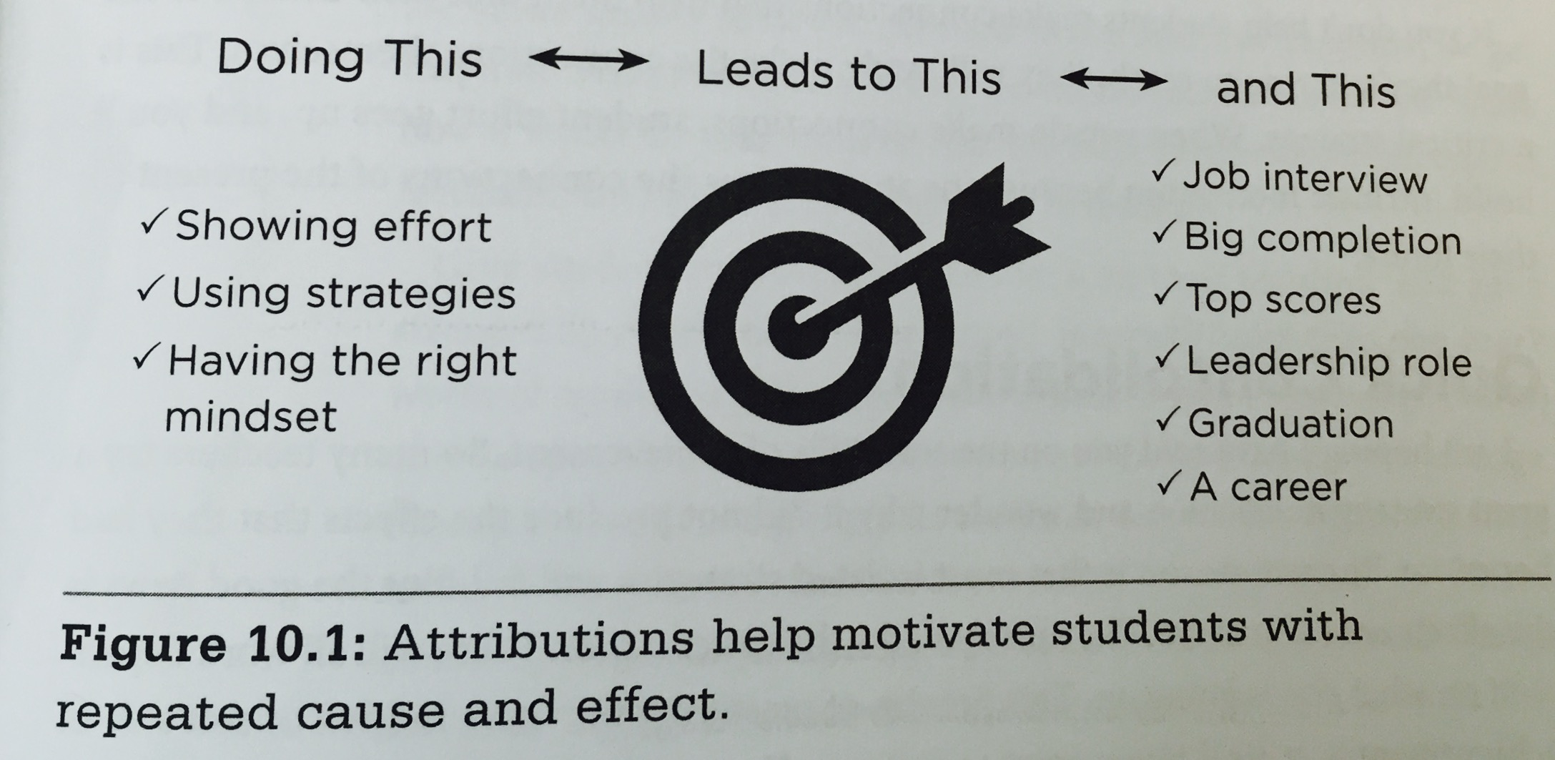

Slide 22
You have to believe that 100% of your students can improve a great deal!

Slide 23
yet

